Slide 1
Samsung washer review analysis
Version 0.1 / 08.25.2017

Slide 2
Goal and method
Goal: Gain new insights on incidents associated with Samsung washers from sites such as Lowes and The Home Depot.
Method: Scrape reviews and rating data of Samsung washer from websites and analyze reviews based on product types/model.

Slide 3
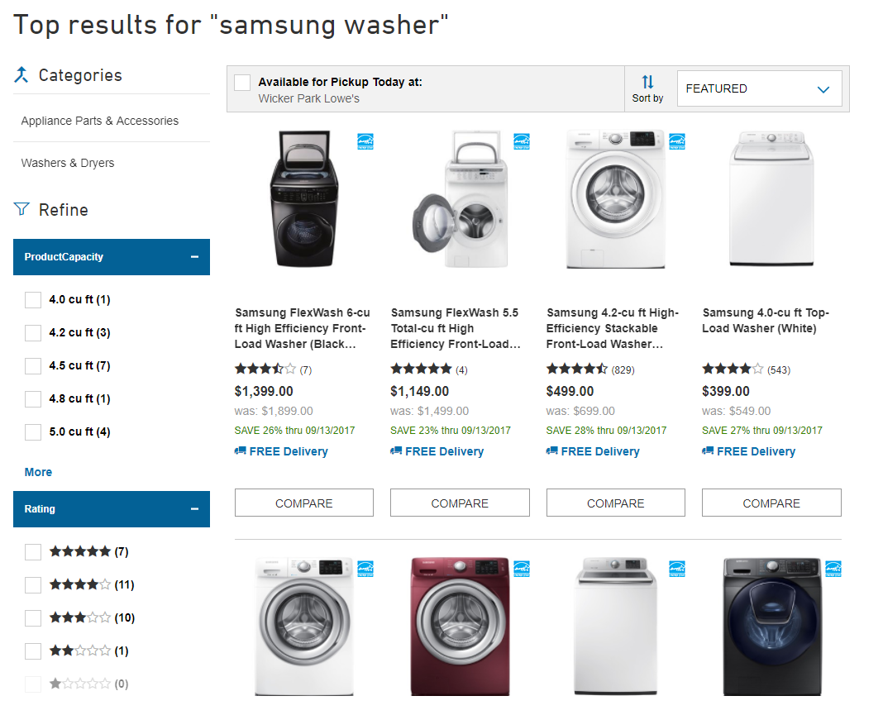
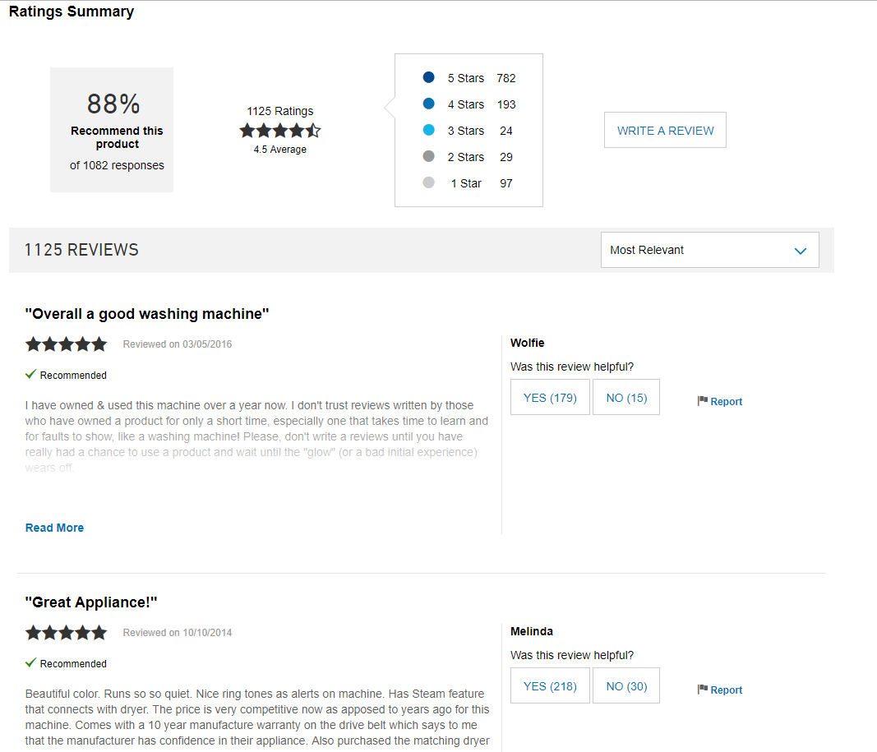
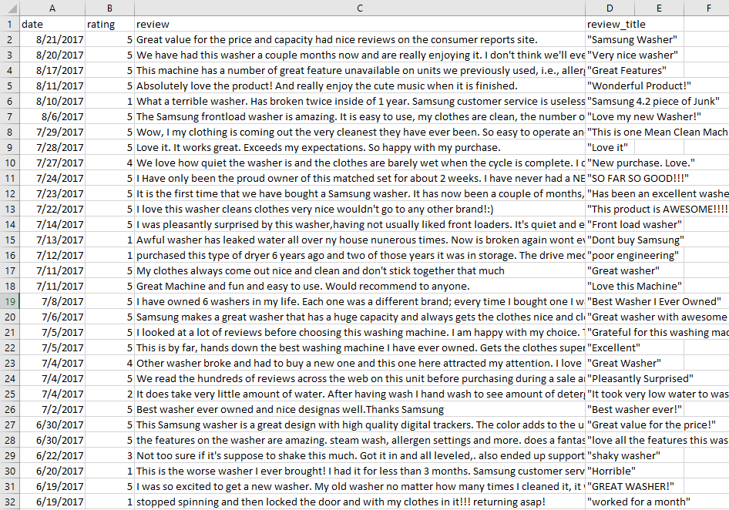
Data scraping from sites
Example from Lowes.com

Slide 4
Overall summary
About 12% of reviews received poor ratings or less than 3 stars.
Most of reviews received 4 and 5 stars
The number of reviews on Lowes.com has grown over the years

Slide 5
Monthly Average rating
More than half of the reviews give a 5-star rating. As a result, the statistical average for all review ratings is about 4.36.
* On Sep 2014, there was only 1-star review in that month, which dropped the trend line.

Slide 6
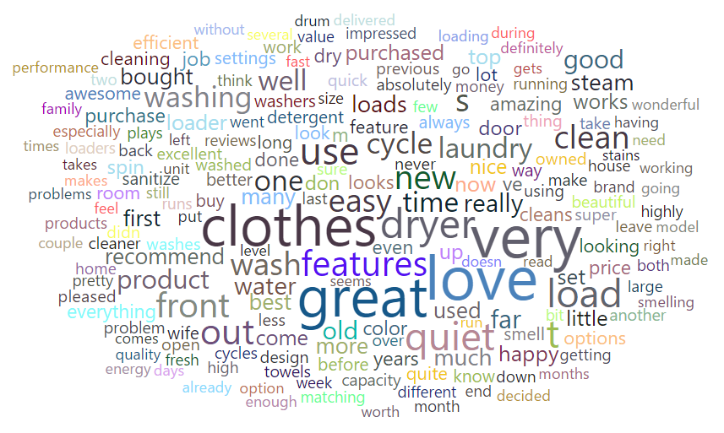
What customs Say
The word cloud shows mostly positive feedbacks on the reviews with 3-star ratings or more and a greater frequency of the words, “great” , “love” and “happy”
Word cloud with 3-star ratings and above

Slide 7
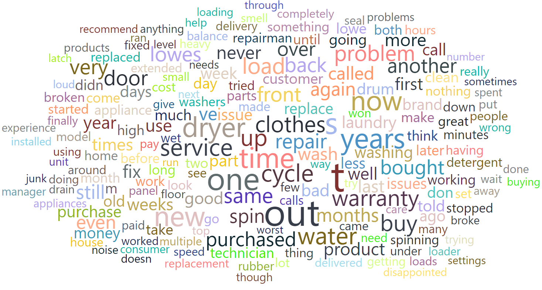
What customs Say
The word cloud shows mostly negative feedbacks on the reviews with 2-star ratings or less and a greater frequency of the words, “Out” , “warranty” and “broken”
Word cloud with 2-star ratings or below

Slide 8
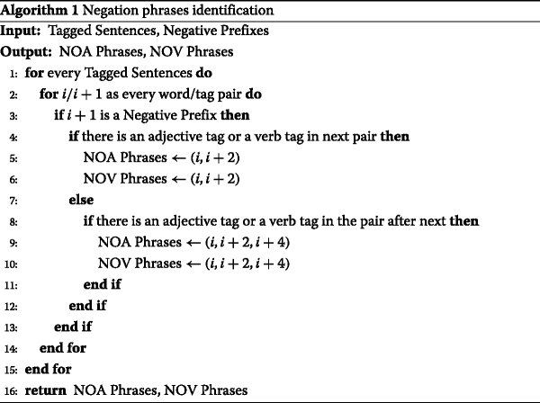
Negation phase identification
https://journalofbigdata.springeropen.com/articles/10.1186/s40537-015-0015-2

Slide 9
Summary

Slide 10
Summary
~24K children injuries and ~100 children fatalities (2010-2015)
2 and 3 year-old children were most likely to be victims.
Most severe injuries were incurred by 1-3 year-old children.
Many incidents were associated with climbing and pulling.

